Slide 1
Linq and it’s impact on .net langauges
Mark Walsh, March 2008

Slide 2
Do you know what a delegate is?
delegate void x();

Slide 3
Do you know what an anonymous delegate is?
button1.Click += delegate(System.Object o, System.EventArgs ex)
{
MessageBox.Show("Click!");
};

Slide 4
Do you understand this?
IEnumerable<T> thing;

Slide 5
An example Linq Statement.
var locals = from c in customers where c.ZipCode == 91822 select new { PersonName = c.LastName, HomeAddress = c.Address };
BUT WHAT DOES IT MEAN?

Slide 6
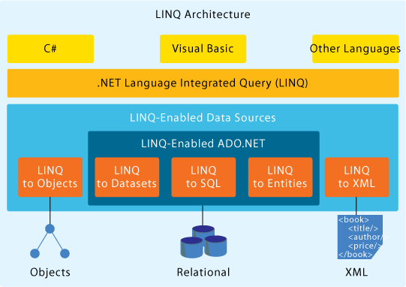

Slide 7


A vision for a new C#.
Several years ago, Anders Hejlsberg (chief designer of C#) and Peter Golde (Compile team lead) thought of extending C# to better integrate data querying.
We need to better integrate data querying into C#
I think it should extend to include everything that implements IEnumerable<T> and IQueryable<T>

Slide 8
A vision for a new C#.
IEnumerable<Customer> locals = EnumerableExtensions.Where(customers, delegate(Customer c) {
return c.ZipCode == 98112;
});
How code would be in C# 2.0
The original vision of C# 3.0
sequence<Customer> locals = customers.where(ZipCode == 98112);

Slide 9
Introducing Lambda expressions.
IEnumerable<Customer> locals = EnumerableExtensions.Where(customers, delegate(Customer c) {
return c.ZipCode == 98112;
});
These are equivalent
IEnumerable<Customer> locals =
EnumerableExtensions.Where(customers, c => c.ZipCode == 91822);

Slide 10
Introducing Lambda expressions.
IEnumerable<Customer> locals =
EnumerableExtensions.Where(customers, c => c.ZipCode == 91822);
Delegate keyword is not required.
Return type is inferred from the expression. The signature of the where method is
public static IEnumerable<T> Where<T>( IEnumerable<T> items, Func<T, bool> predicate)
Return statement is not required.

Slide 11
Just Lambda, not good enough! Problem1: Syntax
IEnumerable<string> locals =
EnumerableExtensions.Select(
EnumerableExtensions.Where(customers, c => c.ZipCode == 91822), c => c.Name
);
In the case of multiple operators, the consumer has to invert his thinking to write the correct syntax
This is the syntax we would prefer to use
sequence<Customer> locals = customers.where(ZipCode == 98112).select(Name);

Slide 12
Just Lambda, not good enough! Problem2: Cohesion.
IEnumerable<string> locals =
EnumerableExtensions.Where(customers, c => c.ZipCode == 91822;
Instead of thinking about the operations that can be performed on Customer, the consumer currently has to know about the EnumerableExtensions class.
The root of the problem for the query above is that we want to add methods to IEnumerable<T>. However, if we were to add operators, such as Where, Select, and so on, every existing and future implementer would be required to implement those methods.

Slide 13
Introducing Extension Methods
Extension methods are basically static methods that are callable through an instance syntax.
public static IEnumerable<T> Where<T>
(
this IEnumerable<T> items,
Func<T, bool> predicate
)

Slide 14
Extension Methods Example
InterfaceFile.dll
interface IDog
{
void Bark(int seconds);
}
Reference
static void Main()
{
IDog d;
d.Bark(); //OK
d.Bark(3); //OK
}
Reference
ClassWeAddedLater.dll
static class DogExtensions
{
public static void Bark(this IDog dog) {
dog.Bark(2);
}
}

Slide 15
So now, with extension methods we can write….
IEnumerable<string> locals =
customers.Where(c => c.ZipCode == 91822).Select(c => c.Name);

Slide 16
If we wanted to write this….
IEnumerable<CustomerTuple> locals = customers.Where(c => c.ZipCode == 91822).Select(c => new CustomerTuple(c.Name, c.Address));
Then we would also have to write this….what a pain!
class CustomerTuple
{
public string Name;
public string Address;
public CustomerTuple(string name, string address)
{
this.Name = name;
this.Address = address;
}

Slide 17
Introducing Anonymous types
locals = customers.Where(c => c.ZipCode == 91822) .Select(c => new { c.Name, c.Address });
This will generate a new (anonymous) type for you and initialise its properties.

Slide 18
Introducing Anonymous types and Object initialisers
locals = customers.Where(c => c.ZipCode == 91822) .Select(c => new { c.Name, c.Address });
This will generate a new (anonymous) type for you and initialise its properties.
But how do we declare the locals variable if we don’t know the name of the type?

Slide 19
Introducing Implicitly Typed Local Variables
var locals = customers.Where(c => c.ZipCode == 91822).Select(c => new { c.Name, c.Address });
var tells the compiler to infer the datatype from the expression.

Slide 20
But it’s still confusing!!!
var locals = customers.Where(c => c.ZipCode == 91822).Select(c => new { c.Name, c.Address });

Slide 21
Introducing Query Expressions
The language design team then designed a syntax that is closer to SQL, known as query expressions

Slide 22
Introducing Query Expressions
var locals = customers.Where(c => c.ZipCode == 91822).Select(c => new {PersonName = c.LastName, HomeAddress = c.Address });
These are equivalent
var locals = from c in customers where c.ZipCode == 91822 select new { PersonName = c.LastName, HomeAddress = c.Address };

